Slide 1
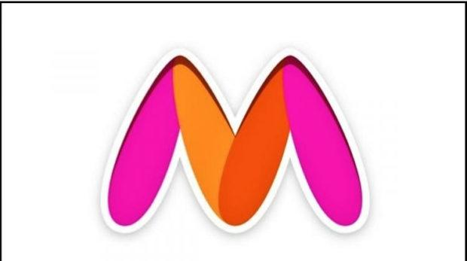
Myntra Analysis

Slide 2
Introduction
Founded in 2007, headquartered in Bangalore, India
Acquired by flipkart in 2014, leading online fashion platform
Partners with over 3,000 brands, offering more than 600,000 products
Utilizes AI for personalized fashion recommendations

Slide 3
Technology Used
Uses 31 technology products and services including HTML5, jQuery, and Google Analytics, according to G2 Stack.
Myntra is actively using 78 technologies for its website, according to BuiltWith. These include Google Tag Manager, and Google Font API.

Slide 4
Business Model
B2C
Fashion e-commerce platform with multi-brand partnerships.
Mobile-first approach with high engagement via Myntra Studio.
Focus on personalized fashion through AI technology.
Influencer marketing and brand collaborations.

Slide 5
Revenue Model
Main Revenue Streams
Commission-based sales from partner brands.
Revenue from private labels (e.g., Roadster).
Advertising fees for product visibility on the platform.
Myntra Insider: Loyalty program generating subscription revenue.

Slide 6
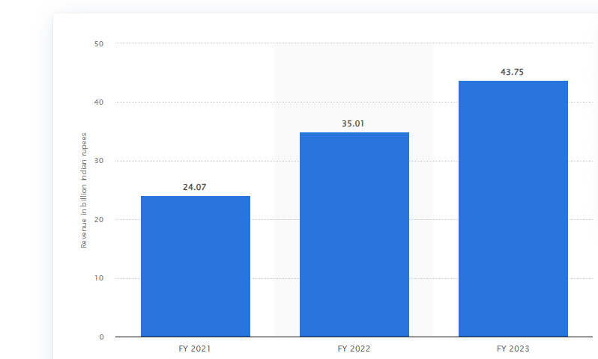
Operating Revenue FY21 to FY23

Slide 7
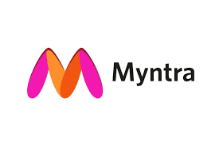
Social Media Feedback
Positive
'Myntra's collection is always trendy! I love their fast shipping.' - Twitter
Neutral
'Good product quality but delivery was delayed by a few days.' - Instagram
Negative
'Terrible customer service, I had to wait weeks for a refund!' - Google Reviews

Slide 8
SWOT Analysis
Strengths
Wide variety of fashion products and strong brand partnerships.
Weakness
Delivery delays and customer service issues.
Opportunities
Growth in e-commerce and demand for sustainable fashion.
Threats
Strong competition from Amazon, Flipkart, and AJIO.

Slide 9
Customer Sentiments
Most people have a favourite store or a boutique to cater to all their apparel needs.
Myntra has created a good image in their buyers' hearts giving the comfort of ordering the product by sitting at home with a one-click.
Plus giving more comfort by the cash on delivery mode.
30 days for returning the product.

Slide 10
Key Competitors
Amazon
Flipkart
AJIO

Slide 11
Competitive Landscape
Amazon
Global market reach and vast product range beyond fashion.
Prime benefits including fast delivery and exclusive deals.
Customer satisfaction driven by convenience, but lacks Myntra's fashion focus.
Flipkart
Parent company of Myntra, with stronger market penetration in tier-2/3 cities.
Competitive pricing and larger customer base, but less fashion-focused than Myntra.
AJIO
Reliance-backed, AJIO is a strong competitor with a distinct fashion appeal.
Exclusive fashion labels and aggressive pricing, attracting value-conscious consumers.
Increasing social media presence, but lacks the AI-driven personalization Myntra

Slide 12
Comparative Analysis
Product Range
Myntra focuses on fashion, while Amazon and Flipkart have broader offerings.
Delivery Speed
Amazon leads with Prime, while Myntra has room for improvement.
Fashion Focus
Myntra and AJIO both prioritize fashion, but Myntra’s AI-based personalization is a key differentiator.
Pricing
Flipkart and AJIO offer more aggressive pricing, appealing to budget-conscious shoppers.

Slide 13
Strategic Recommendations
Improve logistics for faster delivery and smoother returns.
Expand eco-friendly and sustainable fashion categories.
Enhance customer service and response time.
Use AI for deeper customer engagement and product recommendations.

Slide 14
Conclusion
CONCLUSION

Myntra has become a worth competing fashion e-commercecompany because of its unique business model and attractivediscount offers. Myntra also keeps on revising its business strategieswith exigencies of time. It started with the B2B model and shifted tothe B2C model. Thus Myntra offers good competition to e-commerce companies, especially in the apparels sector.
Myntra has become a worth competing fashion e-commerce company because of its unique business model and attractive discount offers.
Myntra also keeps on revising its business strategies with exigencies of time.
It started with the B2B model and shifted to the B2C model.
Thus Myntra offers good competition to e-commerce companies, especially in the apparels sector.

Slide 15
Thank you

